Slide 1


KESHAV MEMORIAL INSTITUTE OF TECHNOLOGY
AN AUTONOMOUS INSTITUTION - ACCREDITED BY NAAC WITH A GRADE
Narayanaguda, Hyderabad
EtherVote - Empowering Secure Elections with Blockchain Technology
Under the Guidance of : Mr.M.Srinivas
Batch No:7
Team Members
21BD1A6657 – M. Pranava SeshaSai
21BD1A665N– P. Sai Rahul
21BD1A664J– G. Praneeth Sai
21BD1A664H– G. Mouneesh

Slide 2
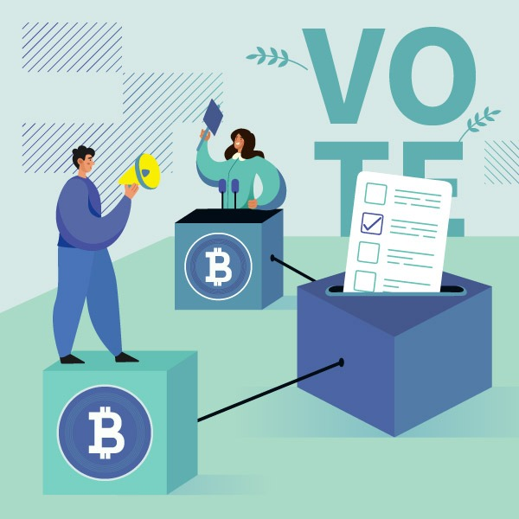
Table of Content
Introduction
Abstract
Objective
Software and Hardware Requirements
Literature Survey
Limitations of Existing Model
Flow Diagram
Model Architecture
Prototype and Smart Contract Creation
Tech Stack Used
References
Conclusion

Slide 3
Introduction
Traditional voting systems face challenges in security, transparency, and accessibility, impacting voter trust and engagement.
This project aims to develop a blockchain-based e-voting system to provide secure, transparent, and accessible voting for all individuals.
By leveraging blockchain technology, the system reduces reliance on centralized authorities, ensuring data integrity and preventing vote tampering.
This solution enhances the electoral process, fostering trust and inclusivity by enabling verifiable and accessible voting options.
With the potential for widespread adoption, the project supports scalable, secure voting applications and promotes democratic participation on a global scale.

Slide 4
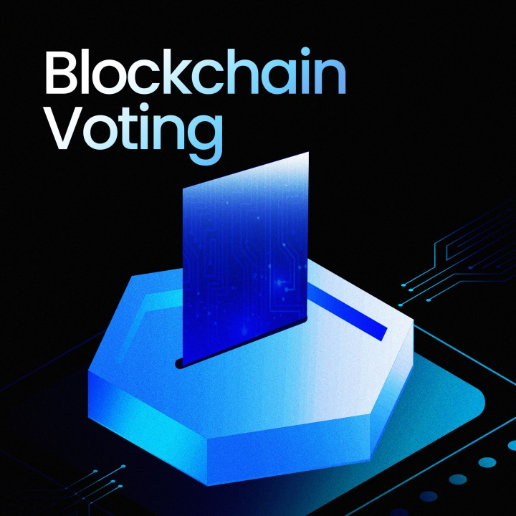
Abstract
This project introduces a blockchain-based e-voting system to improve security and transparency in the voting process.
Each vote is encrypted and stored immutably on the blockchain, allowing real-time verification while ensuring voter anonymity.
The system integrates facial recognition for secure voter authentication, enabling remote access and reducing the need for physical polling stations.

Slide 5

Objective
Develop a secure, blockchain-based e-voting system that enables voters to cast their ballots remotely while ensuring transparency, privacy, and data integrity throughout the election process.
Key Focus: Leverage blockchain technology for tamper-proof voting records and facial recognition for robust voter authentication, promoting trust and accessibility in digital voting.

Slide 6
Software and Hardware Requirements
Software Requirements
Frontend: React.js
Backend:
Node.js
Express.js
Solidity
Blockchain Tools:
MetaMask
Ganache
Truffle
Database: MongoDB
Development Environment: Visual Studio Code, Git, MetaMask Extension.
Hardware Requirements
Intel Core i5/i7 or AMD equivalent: For efficient handling of blockchain operations and local server hosting.
8 GB RAM minimum (16 GB recommended): For running local blockchain nodes and handling concurrent transactions.
SSD with at least 50 GB free space: To store blockchain data, smart contract deployments, and related files.
High-resolution webcam: For facial recognition in voter authentication and reliable internet connection.

Slide 7
Literature Survey
Paper Title | Summary | Finding and Outcome
The Next Gen Election: Design and Development of E-Voting Web Application | proposed a voting system based on the internet. The system has a login page where the voter can login and enter all its information and this will be stored on a centralized server. | According to the paper this will help us in reducing the high cost of voting and time required to conduct the election.
Online Voting System using Cloud | The paper suggests development of voting system where a voter can vote from anywhere through the internet using the system that is based on SQL server and Microsoft Azure cloud and C# in order to implement functions like admitting voters and casting vote. | we have concluded that one of the most important parts of the admin portal is to verify the voter's ID before enrolling them into the system.

Slide 8
Literature Survey
Paper Title | Summary | Finding and Outcome
An Efficient and Secure Students Online Voting Application | a web based voting system having functions like vote capturing and tallying results over the web. The system will help in saving lots of processing time, avoiding human errors during the process and avoiding vote tampering. | Each voter is verified based on the unique ID code . As only unique IDs are allowed, this protects the system from proxy voting. The system will be fast to access, low cost and easy to maintain.
Online Voting System Using Biometric Verification | electoral system which will be online and automated and makes the process of voting easy, safe and reduces overall time required for conducting the election. | The project has two modules. In the first module all the voters are registered into the system and in the second module actual voting takes place.

Slide 9
Literature Survey
Paper Title | Methodology Used | Scope of Improvement
A Brief Analysis of Blockchain Algorithms and Its Challenge | blockchain serves as a ledger that allows transactions to take place in a decentralized manner. This paper focuses on many applications based on blockchain technology, including those covering numerous fields like financial services, government services. | A blockchain database is distributed, fault tolerant and maintains the record in blocks. From this paper we have concluded that Blockchain with its key characteristics, has shown its potential to reshape traditional industries.
Design and Evaluation of a Real-Time Face Recognition System using Convolutional Neural Networks | This paper presented a design and evaluation of a real-time face recognition system using CNN(Convolutional neural network) . | The system using CNN for recognition that give accuracy near about 98%. This system’s accuracy of detection is dependent on variation of training set for a particular person.

Slide 10
Limitations of the Existing E-Voting Models
Security Risks: Many e-voting systems lack robust security features, making them vulnerable to hacking and vote tampering.
Centralization: Traditional e-voting platforms often rely on centralized servers, which can create single points of failure and increase risks of data manipulation.
User Authentication Issues: Existing models may not effectively verify voter identities, leading to potential cases of identity fraud or unauthorized voting.
Lack of Transparency: Voters have limited ways to verify that their votes are counted accurately, which reduces trust in the voting process.
Accessibility Constraints: Some systems require physical presence or specific devices, limiting access for remote voters or individuals with disabilities.

Slide 11
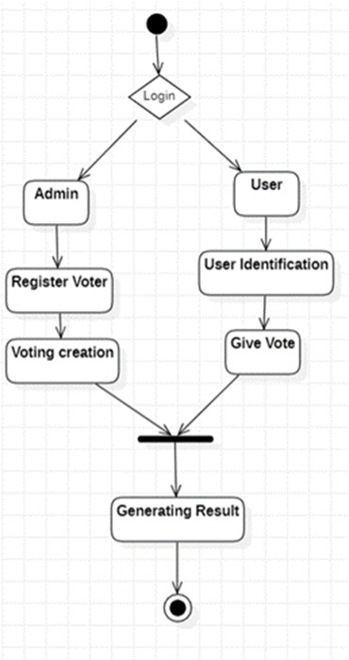
Flow Diagram

Slide 12
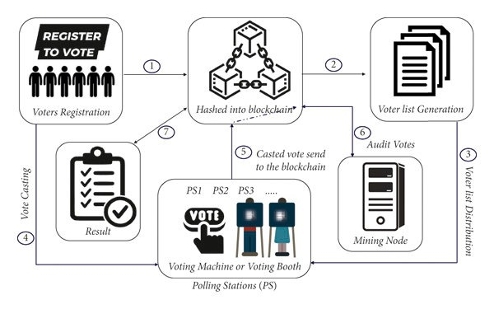
Model Architecture

Slide 13
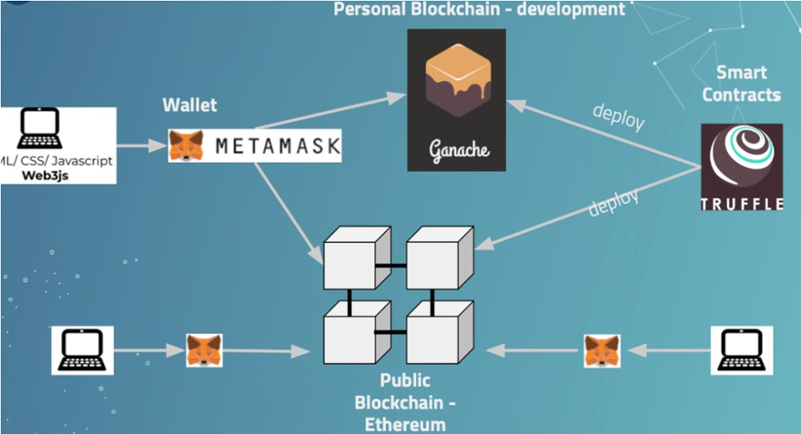
Model Architecture

Slide 14
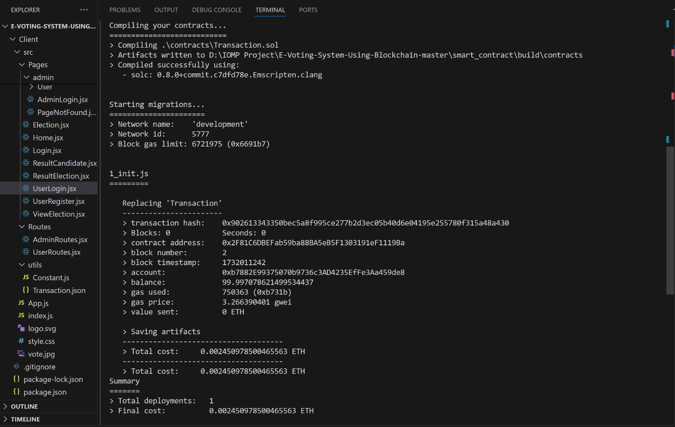
Smart Contract Creation

Slide 15
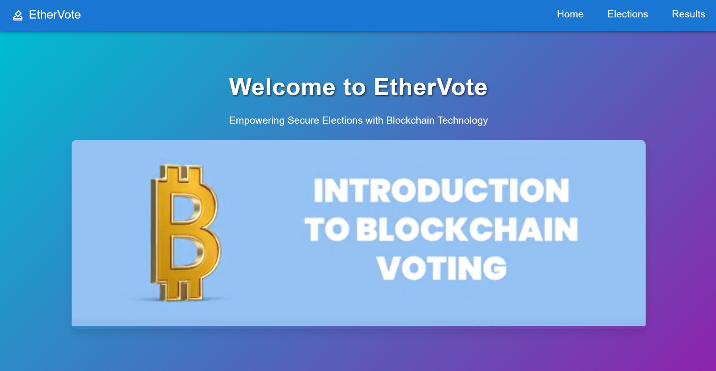
Prototype

Slide 16
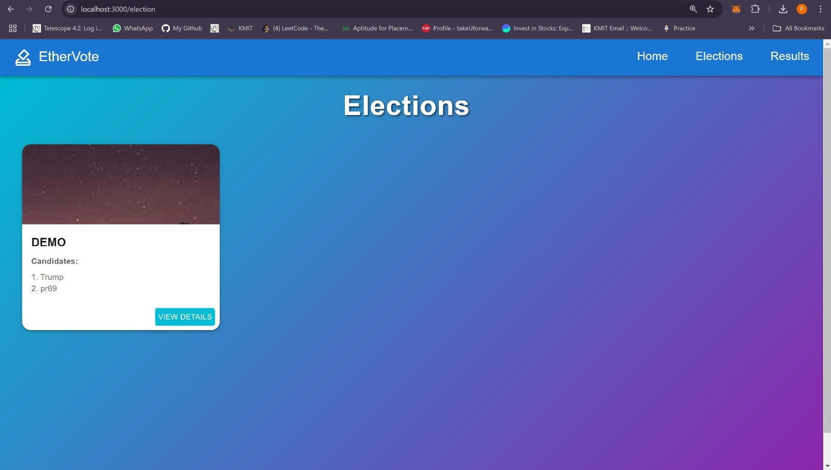
Prototype

Slide 17
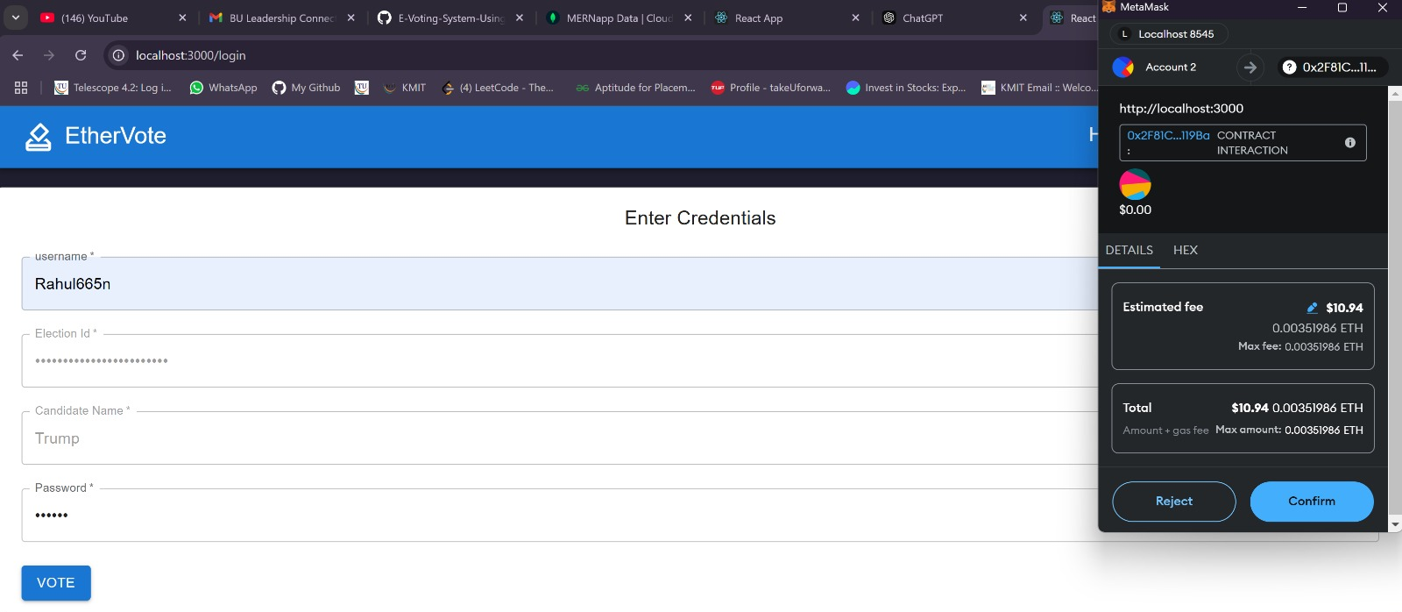
Prototype

Slide 18
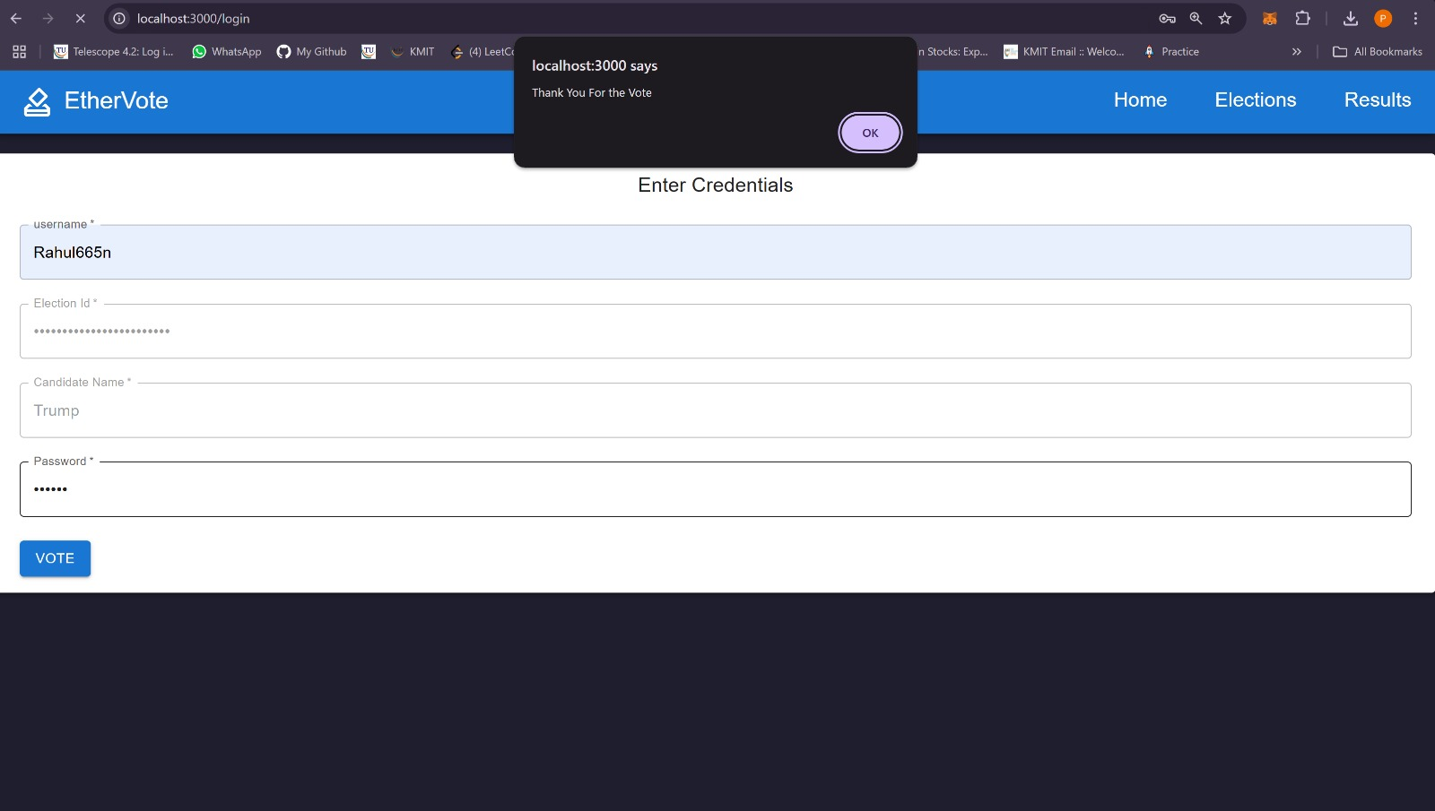
Prototype

Slide 19
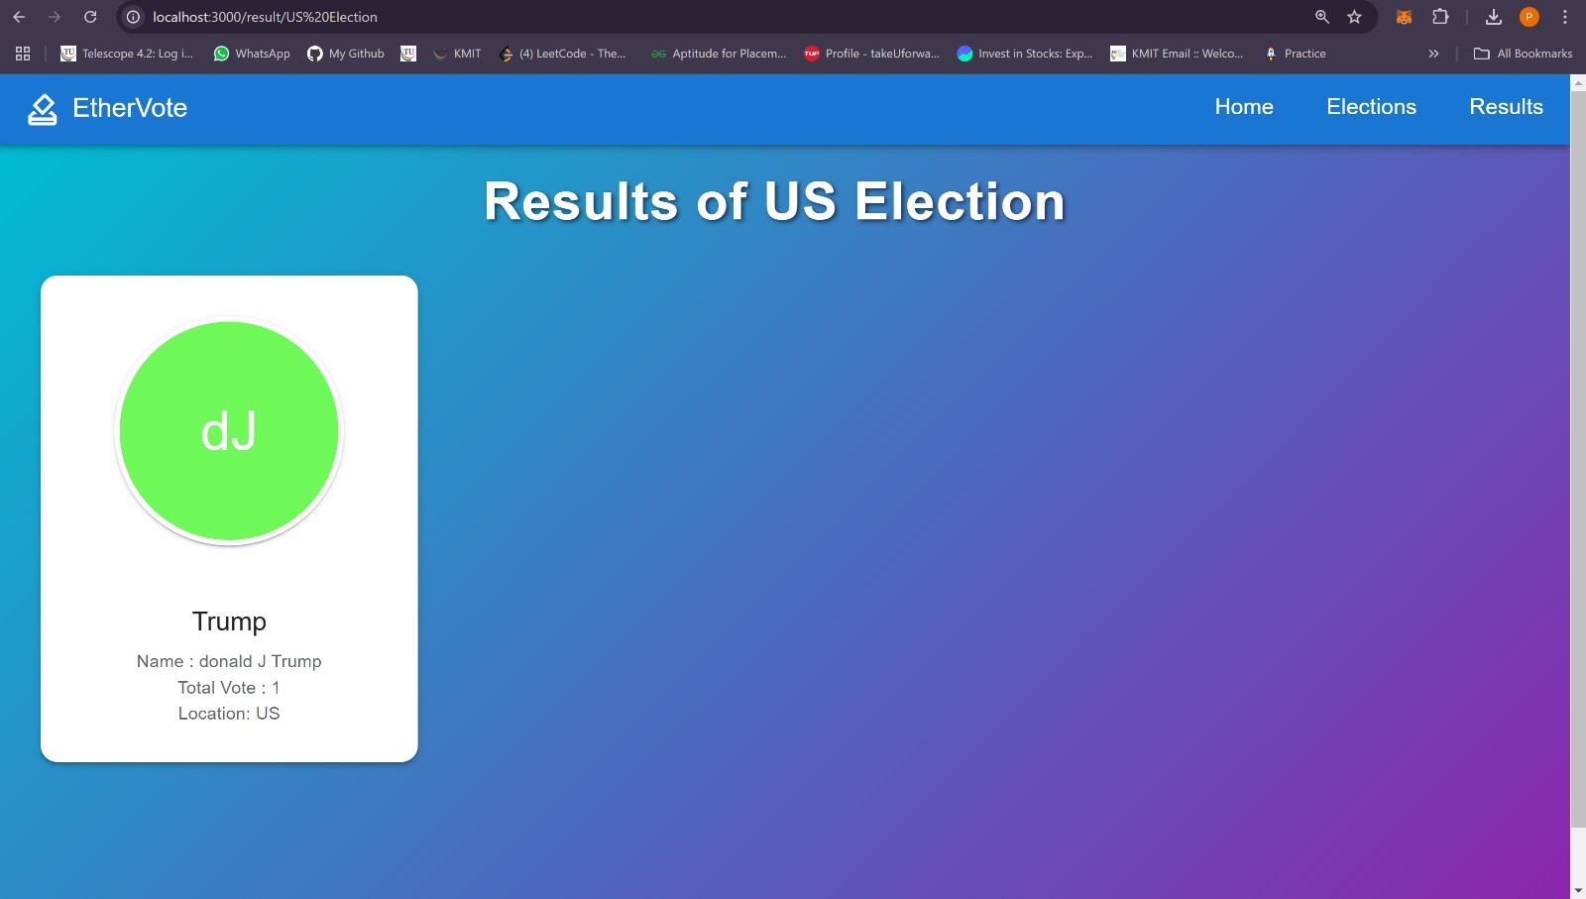
Prototype

Slide 20
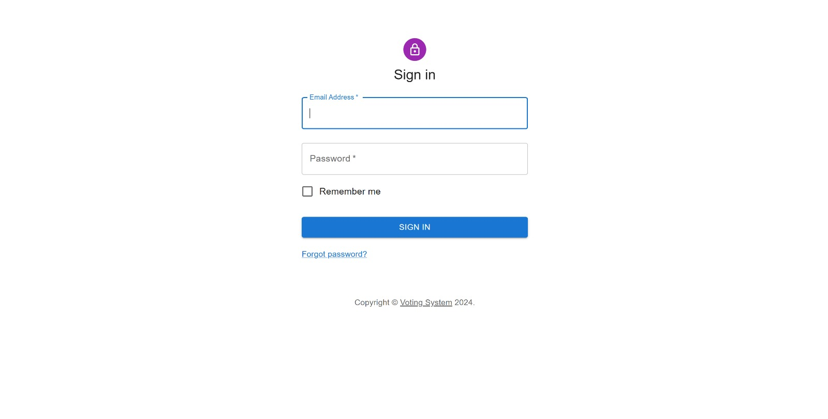
Prototype

Slide 21
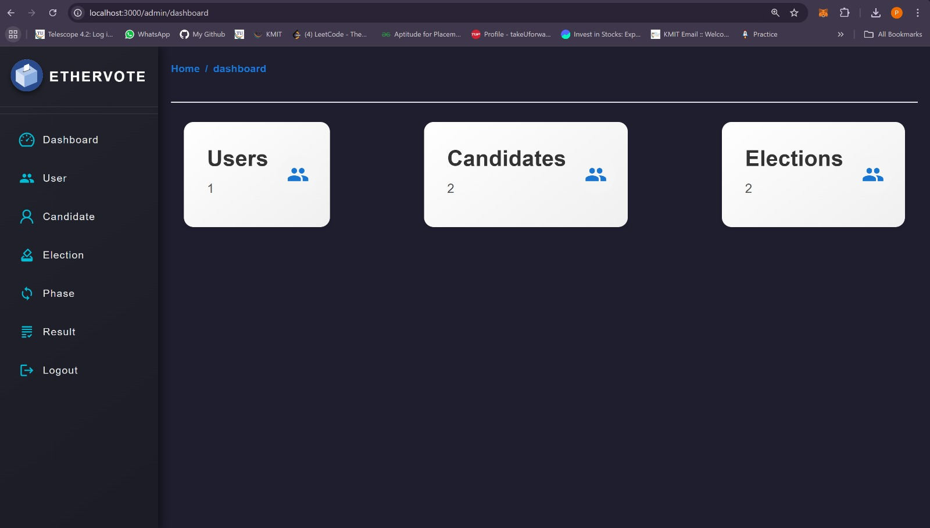
Prototype

Slide 22
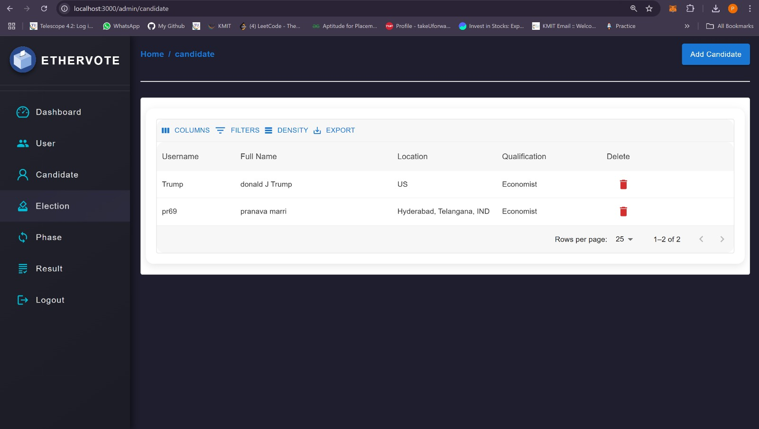
Prototype

Slide 23
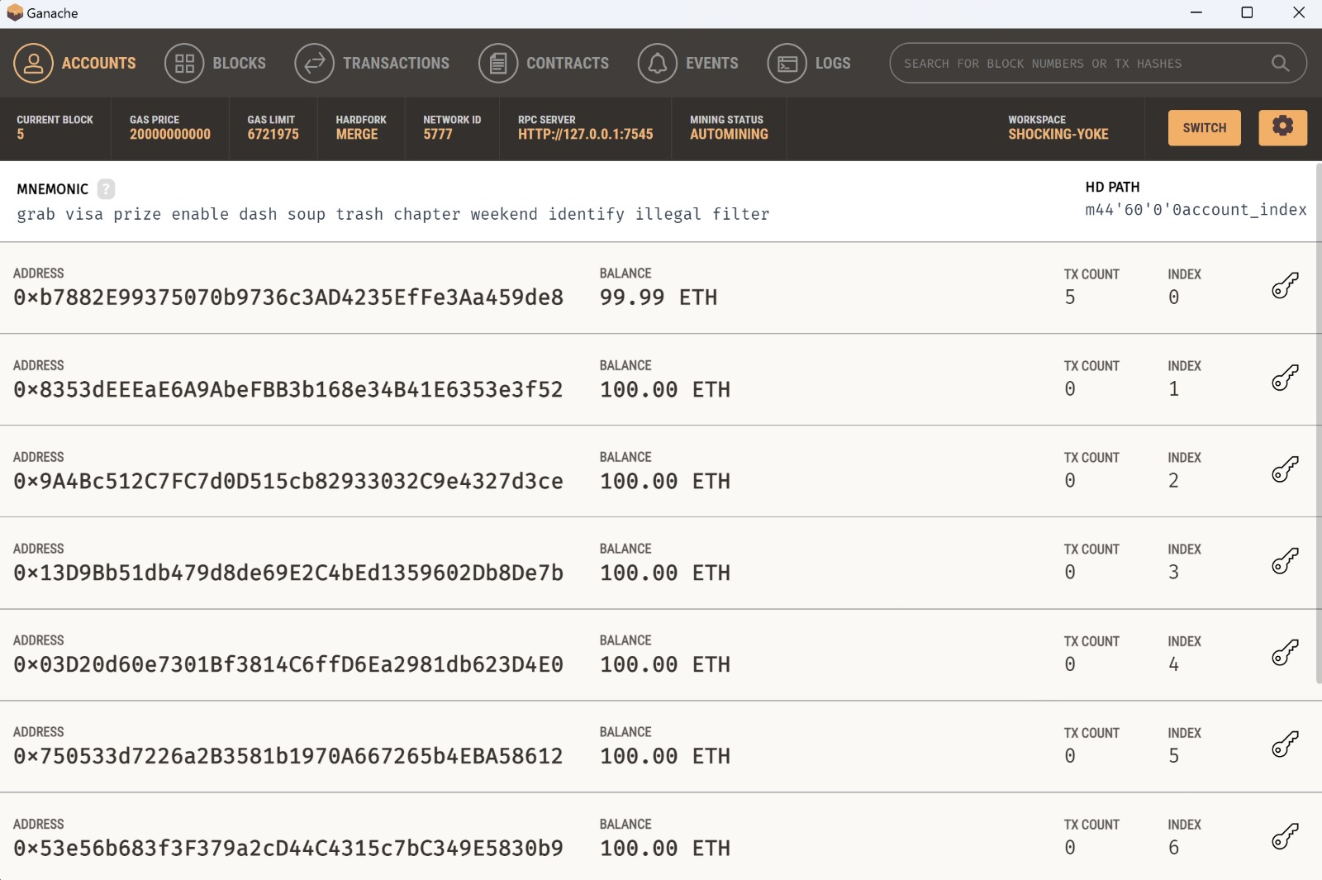
Prototype

Slide 24







Tech Stack Used
ReactJS
NodeJS
Metamask
Truffle Suite

Slide 25
References
Raghav Chhabra, Uday Vohra, Vishrant Khanna, Aditya Verman, Poonam Tanwar, Brijesh Kumar, The Next Gen Election: Design and Development of E-Voting Web Application, Issue 10-12 June 2020, IEEE
Ramya Govindaraj, P Kumaresan, K. Sree harshitha, Online Voting System using Cloud, Issue 24-25 Feb. 2020, IEEE
Bhushan M. Pawar, Sachin H. Patode, Yamini R. Potbhare, Nilesh A. Mohota, An Efficient and Secure Students Online Voting Application, Issue 8-10 Jan. 2020, IEEE
Mrunal Annadate, Online Voting System Using Biometric Verification, Issue April 2017, ResearchGate
Rajalakshmi Krishnamurthi , A Brief Analysis of Blockchain Algorithms and Its Challenges, Issue January 2021, ResearchGate
Pranav KB, Manikandan J, Design and Evaluation of a Real-Time Face Recognition System using Convolutional Neural Network, Issue 2019.

Slide 26
Conclusion
Project Overview:
The E-Voting System Using Blockchain combines blockchain technology with facial recognition to create a secure, transparent, and efficient voting process. The system ensures that every vote is counted accurately and securely, eliminating risks such as vote tampering or unauthorized access.
Impact:
Enhanced security and transparency through blockchain's decentralized architecture.
Accessibility for remote voters, enabling higher participation.
A cost-effective, user-friendly solution that builds trust in the electoral process.

Slide 27
Conclusion
Achievements:
Successfully implemented Ethereum-based blockchain for secure vote recording.
Achieved robust voter authentication using facial recognition technology.
Future Work:
Incorporate support for Hyperledger to make the system cost-free by removing cryptocurrency dependencies.
Enhance features like real-time vote tracking and multilingual support for broader usability.
Explore additional authentication mechanisms for further strengthening security.

